Slide 1
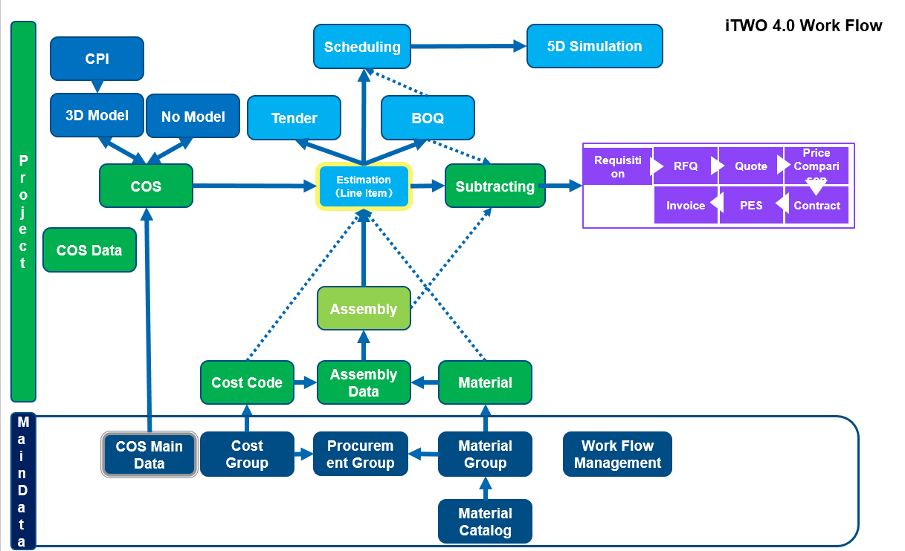
Project Management- Module Chart in iTWO
Import data
Export data
Project Calendar—Define working time & exception
Scheduling—Define and manage schedule
5D Simulation—Simulate construction progress, along with cost curve

Slide 2
Project Management - Workflow
General Workflow of Project Management
Subcontracting
3D Model
COS Instance
Estimation(Line item)
Scheduling
Cos Instance Main Data
Material Catalog
Cost Group
Material Group
Procurement Group
3D - 4D - 5D
Resource Group
Notes:
“m2” for painting; “pc” for Lamp

Slide 3
Core Info
Core Item Name | Description | Code
Project | LJ Demo Project P11 | LJP11
Model | Small House M01 | M01
Estimate | Estimate E01 | E01
BoQ | BoQ01 | BoQ01
Schedule | Schedule S01 | S01

Slide 4
Model

Slide 5
Model Steps
Create a Project;
Create a Model;
Create a model file and import BIM Model;
Show model details by camera position/filter/cutting plane;
Run Model Comparison;

Slide 6
Model Overview
BIM Model Part is responsible for all model related operations, including:
Attribute check and model export from CAD system
Model import and overview in iTWO 4.0
Set up object filters and cutting planes for section view

Slide 7
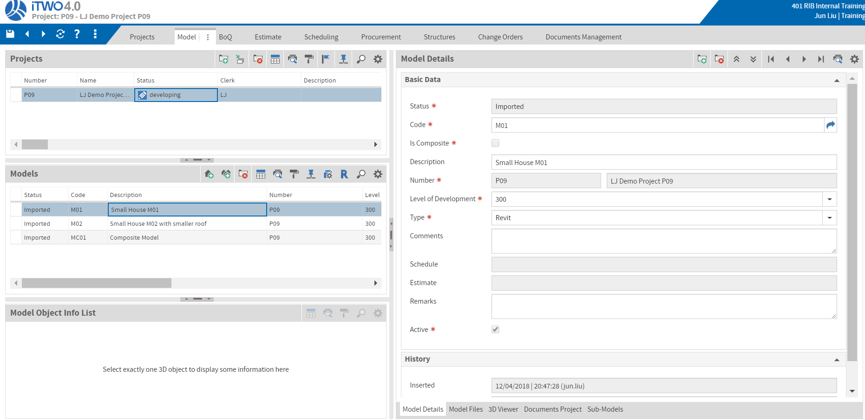
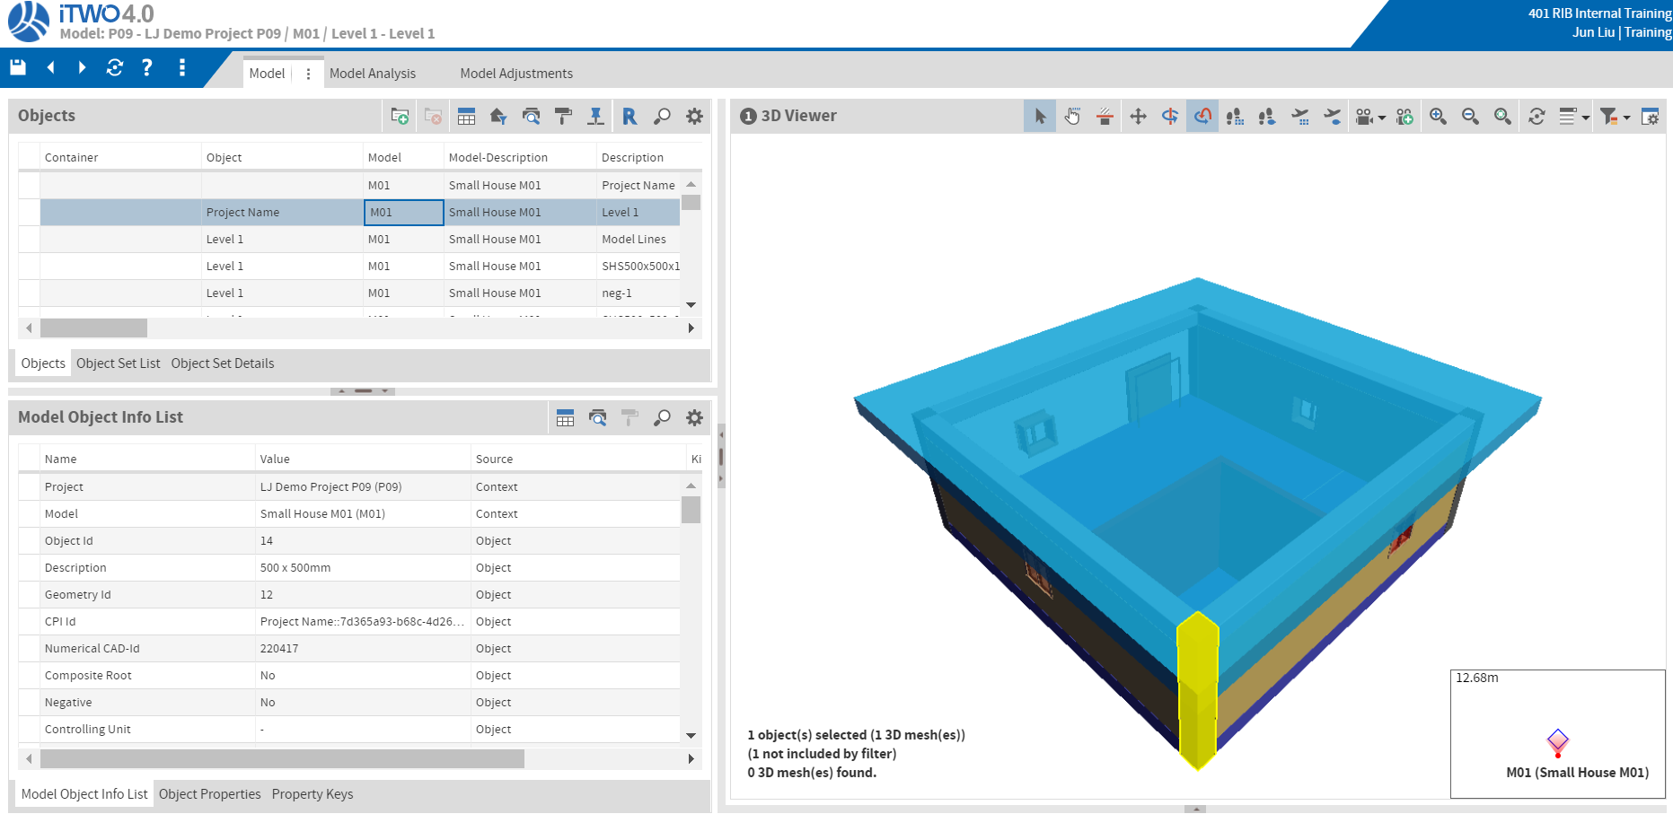
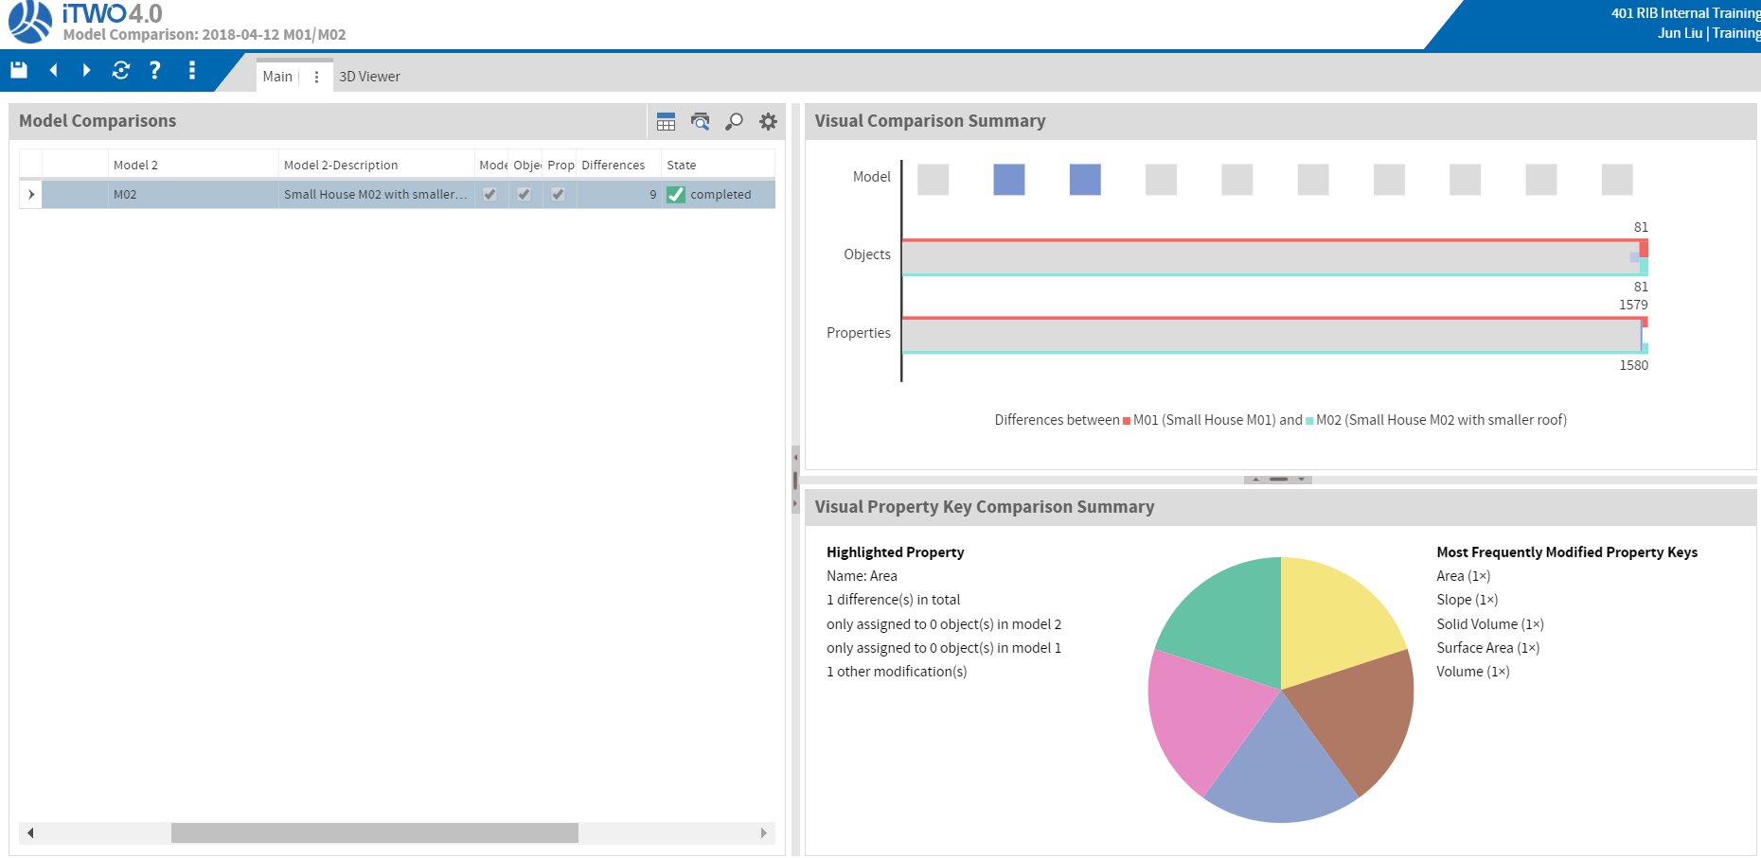
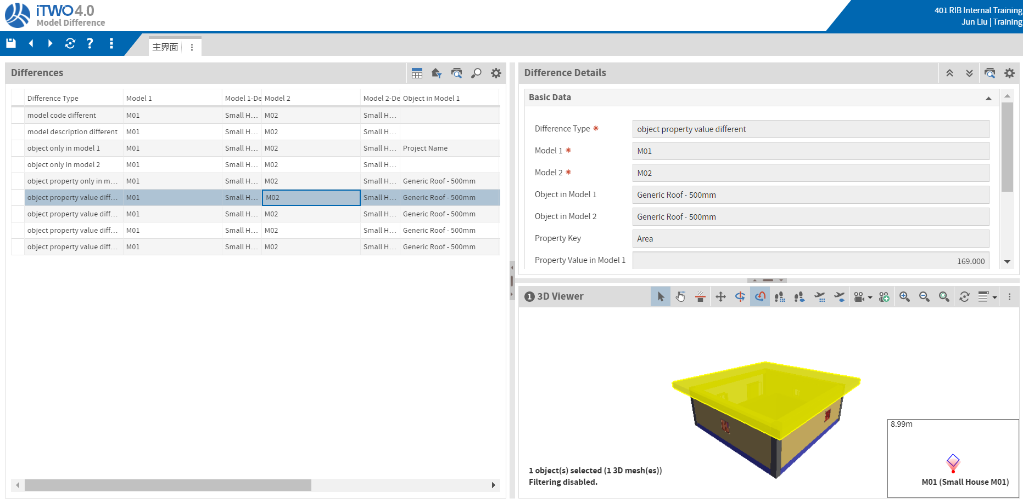
Model Tabs
Open 4 tabs:
Model List in Project & Model Details
Model Comparison List & Model Comparison Details

Slide 8
Model Demo
Support different kinds of Model File Format: Revit/Bentley/Tekla. Support Import BIM files.
Revit iTWO3D Plugin.
[Demo] Open Model List tab, show model list. Single Model and Composite Model (in sub-models container).
[Demo] Open the Model Details tab
[Demo] Zoom in/out, different camera position and self-defined camera.
[Demo] Select one object, and check it details.
[Demo] Filter and self-defined Filter.
[Demo] Cutting Plane.
[Demo] Open Model Comparison List tab, model comparison.
[Demo] Open Model Comparison Details tab, model differences details.

Slide 9
Estimate

Slide 10
BoQ & Estimate Overview
Quantity Survey is in charge of project quantity take-off based on regional standard method of measurement.
Estimate allows to calculate costs and prices for different contract types (lump sum, cost plus, fixed price) in early phases on a very plain level.
COS is a system that can be used to assist in the generation of accurate and timely estimates. It can contain information about:
the costs
the quantities
the factors
the location
the time
Costs
Quantities
Construction System
Factors
Location
Estimate
Time

Slide 11
BoQ & Estimate Workflow
Construction System Master
Leading Structures
QS
Construction System Instance
Assembly
Activity Template
BoQ
Controlling Group
Location
Work Item
Quantity Take-off
Cost Estimate with Resource
Master Data Prep.
Markup & Surcharge(Estimate Rule)
Management Adjustment
(Cost Risk & Factor)
Bid Creation

Slide 12
BoQ & Estimate Steps
Create a BoQ and import BoQ File;
Create a Estimate;
Create a COS instance header, link COS and Model & Estimate;
Create COS instances from COS Master Lib, attach Model Objects into COS instances.
Evaluate/Calculate/Apply COS to Estimate Line Items.
Manually create new line items based on BoQ.
Check Estimate Line Items details: link to COS for Model Object; link to Schedule Activity for Time; link to COS for Quantity and Cost; Link to Procurement Package for Procurement; Link to BoQ for Bid;
Find the Related Objects from Selected Line Item and Find the Related Line Item from Selected Object(s)
Assign Rule to Line Item;
Wizard->Updater Estimate to check latest cost and BoQ;
Show Grand Total, Line Item Total and Filtered Total;
Print out Report->Total Job Cost Report

Slide 13
BoQ & Estimate Tabs
Project Estimate Tab;
BoQ Details;
BoQ Report Page;
COS Instance Details;
COS Master Lib;
Estimate Details;
Total Cost Report Page;

Slide 14
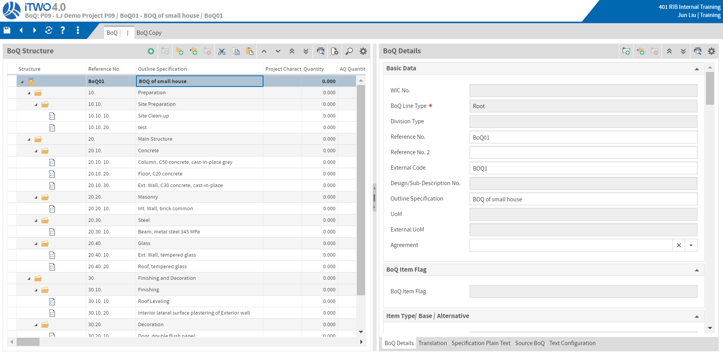
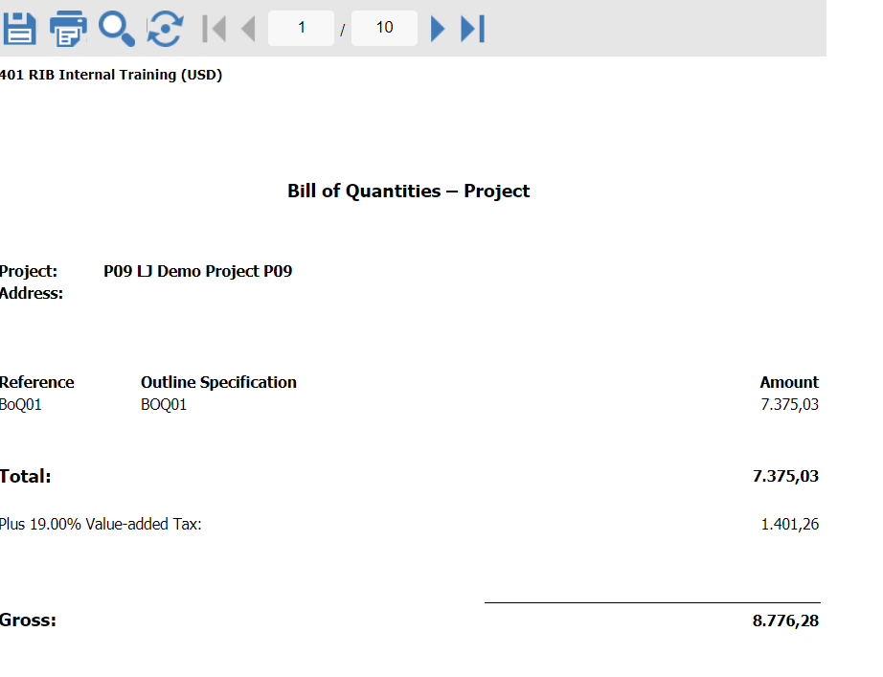
BoQ & Estimate Demo - BoQ
We have 3 ways to create BoQ: Import, manually create and copy;
Wizard->GAEB Import
Show BoQ Details.
Print BoQ Report Report->Project BoQ.

Slide 15
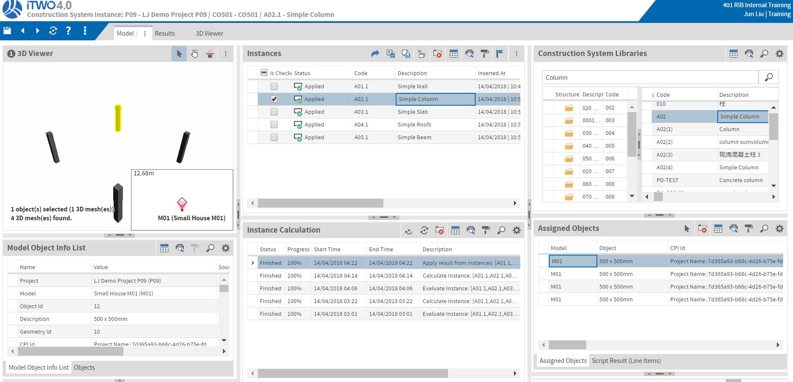
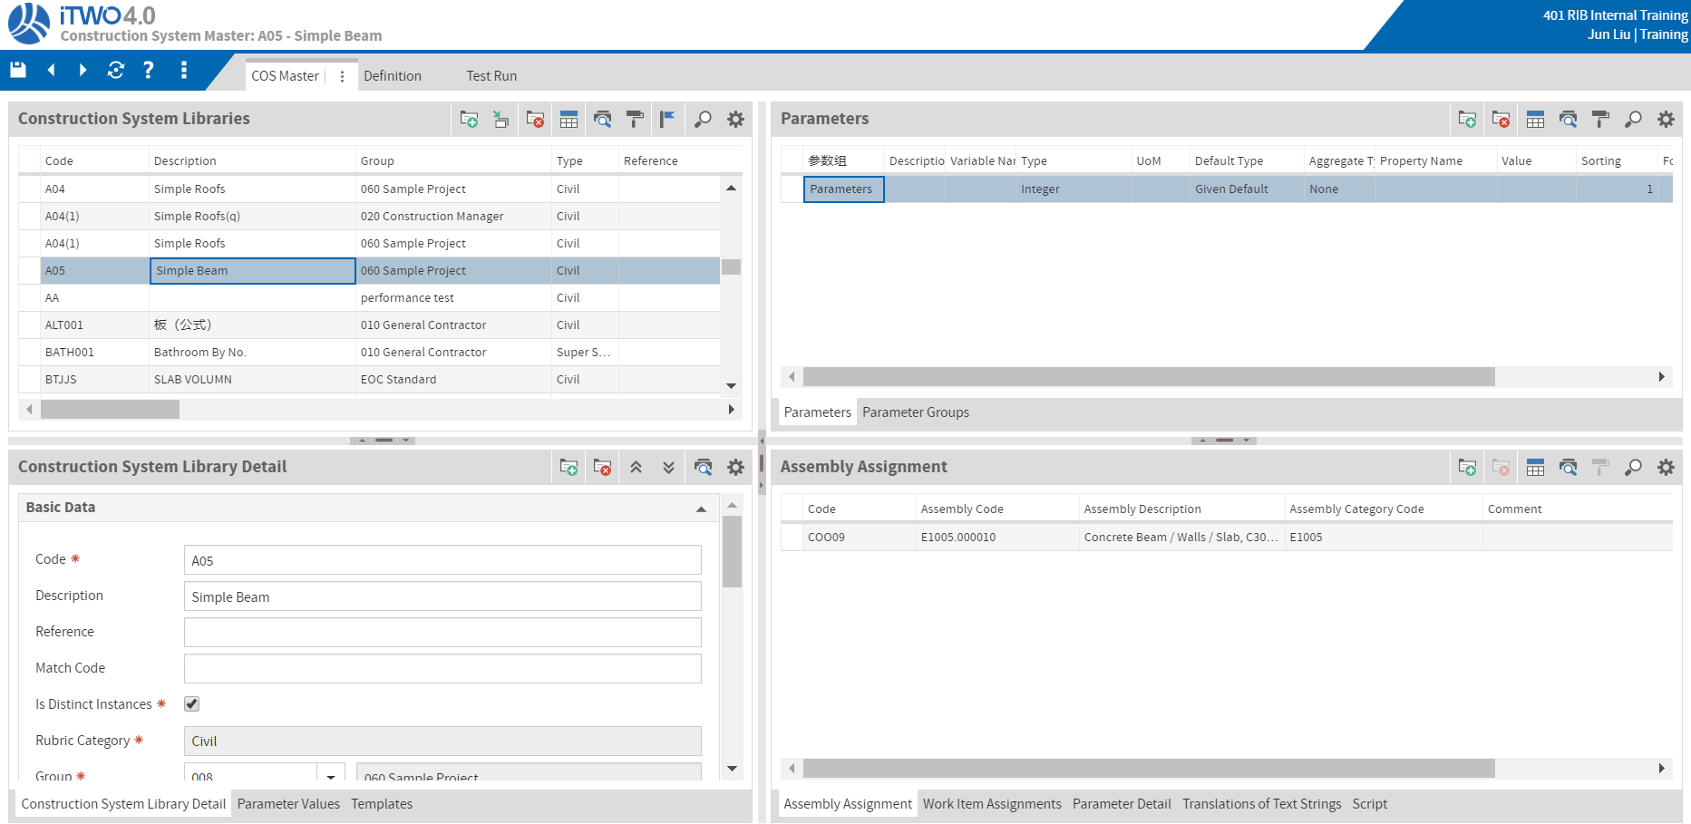
BoQ & Estimate Demo - COS Instance
Create COS instance from COS Master Lib, and assign Model Objects (filtered) to that COS instance.
Evaluate/Calculate/Apply to Estimate Line Items. Show Instance Calculation History.
Show for each COS instance, which model objects are assigned.
Show COS Master Lib Details and Scripts.

Slide 16
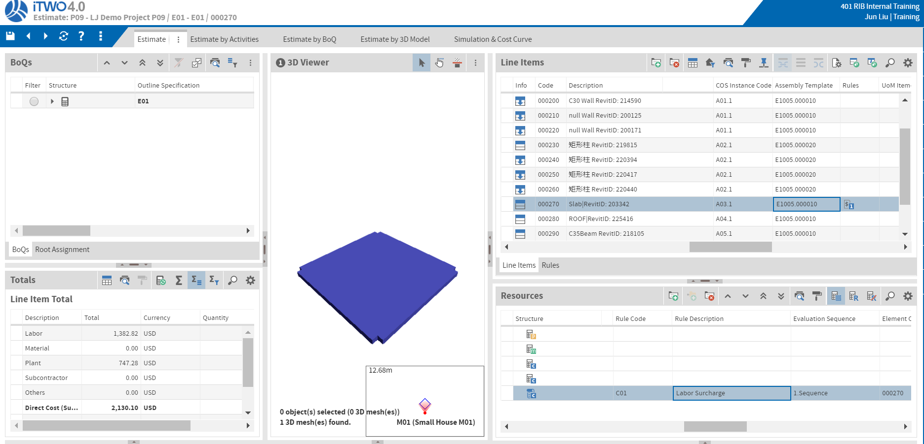
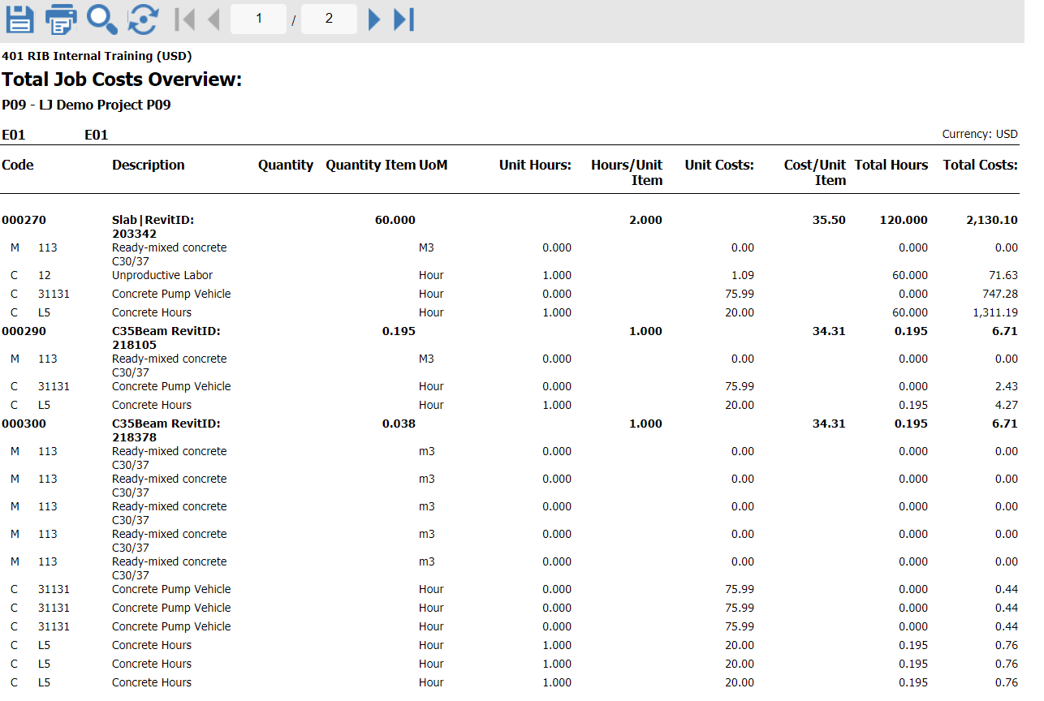
BoQ & Estimate Demo - Estimate
Show Line Item Details;
Show Line Item Cost by Resources.
Add a Rule and Wizard->Update Estimate; show updated cost;
Show can add Line Item manually;
Show Find the Related Objects from Selected Line Item and Find the Related Line Item from Selected Object(s)
Show Grand Total, Line Item Total and Filtered Total (by filter BoQ Items);
Print out Report->Total Job Cost Report

Slide 17
Schedule

Slide 18
Schedule Overview
Scheduling Model is used to plan and manage construction. Critical path could be generated automatically.
User is able to input actual construction progress and its status could be revealed on Gantt vividly.
LOB provides potential construction conflict at different location.
ITWO Benefit:
Multiple options to build up schedule
Different version schedule comparison
Critical path generated automatically
Actual schedule and planned schedule comparison
Different project schedule comparison
LOB reveals construction conflict on different location

Slide 19

Schedule Workflow
General Workflow of Project Management
1.Create Scheduling
2.Define Location/Constraint/Productivity/Progress/Relationships
3.Generate Critical Path, Create different version scheduling
4.Display LOB
5.Input Actual progress, display progress line
6.Display different schedule across projects

Slide 20

Project Control Workflow
Progress Control
Input actual dates
View config.
Show actual schedule
Set Report date
Actual progress
View config.
Show & analyses progress line
Multi project scheduling
Enhanced filter
Grouping by projects
Compare schedules

Slide 21
Schedule Steps
Create or Import Schedule;
Show Activity Details;
Show LOB;
Show GANTT with Critical Path/Baseline
Show GANTT with plan/actual scheduling comparison
Show Progress Line;
Show Multiple Project GANTT schedule;
5D Simulation;

Slide 22
BoQ & Estimate Tabs
Project Scheduling Tab;
Schedule Planning Tab;
Schedule LOB Tab;
Schedule GANTT Tab;
Schedule Performance Tab;
Schedule GANTT Tab for multi project;
Estimate Details – Simulation and Cost Curve Tab;

Slide 23
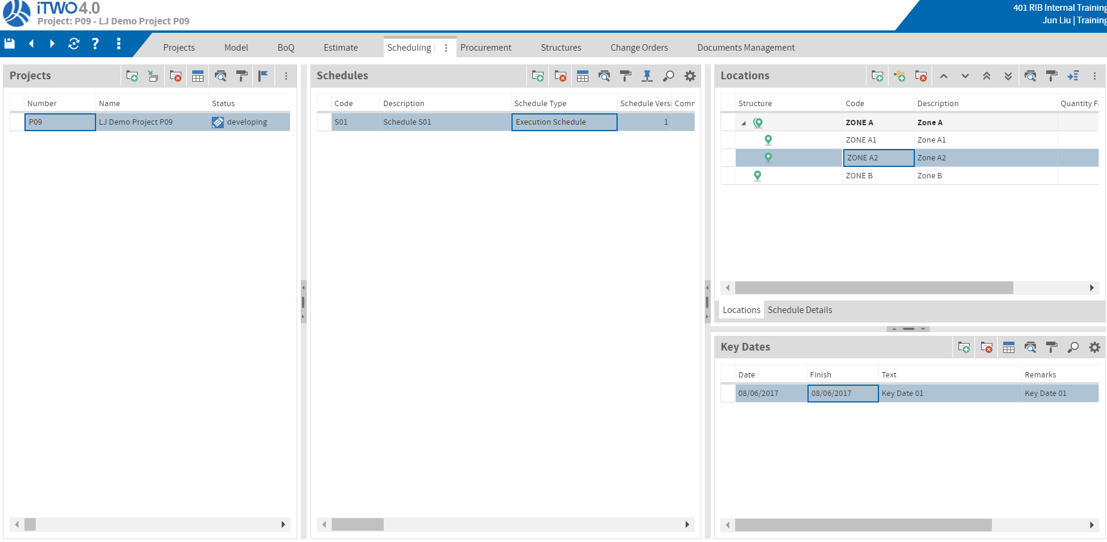
Schedule Demo - Project Schedule
Create a Schedule from Project Scheduling Page.
Define Locations and Key Date.

Slide 24
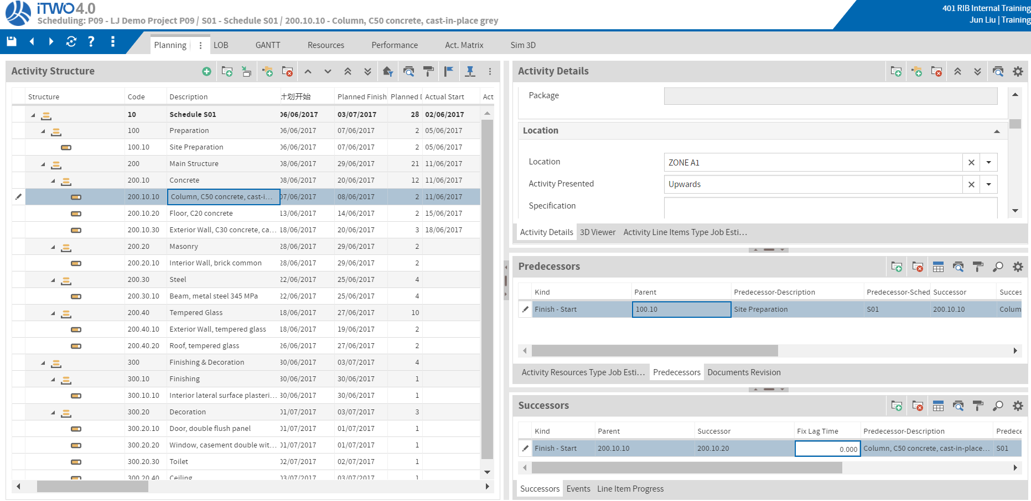
Schedule Demo – Schedule Planning
Multiple options to build up schedule: Import Project File or manually added:
Manually add an activity and change to milestone.
Show Activity Details:
Events
Location/Activity Presented
Template
Constraint/Date
Planned Start/Finish/Duration
Type: fix units/time/work
Productivity
Calendar/Schedule Method
Show Activity’s Predecessors and Successors.

Slide 25
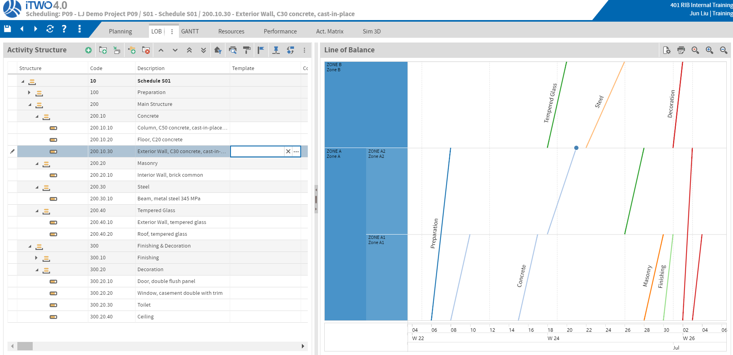
Schedule Demo – Schedule LOB
LOB reveals construction conflict if 2 activities happened in the same location within the same time slot; and LOB can improve efficiency if one location does not have activities.
Can change activities' start/finished time in LOB.

Slide 26
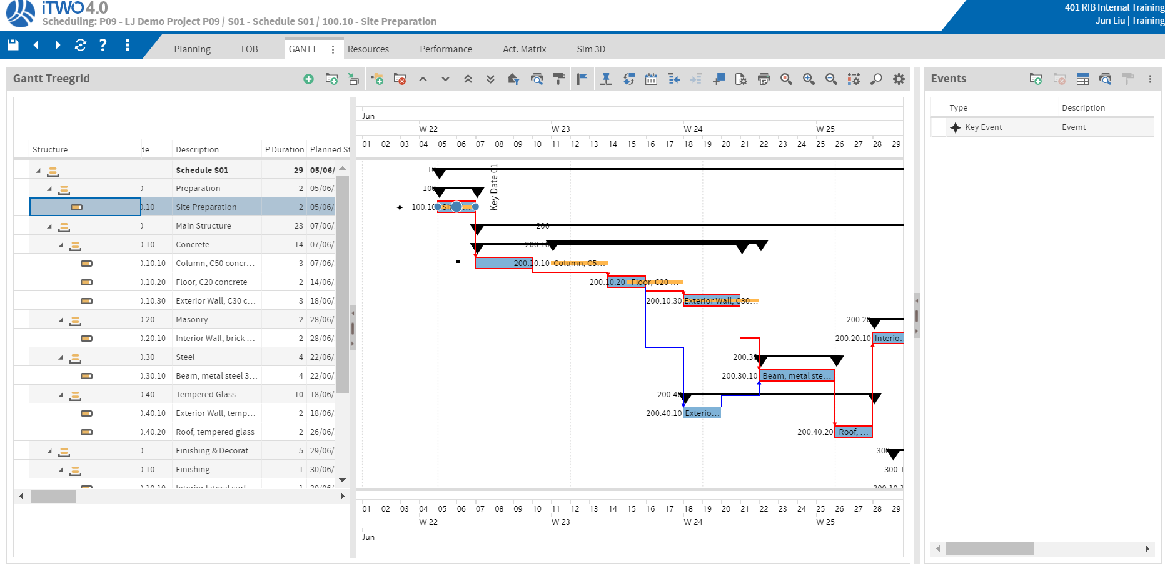
Schedule Demo – Schedule GANTT
Show Critical Path. Wizard->Critical Path;
Different version schedule comparison: Define/Show Baseline Version. Wizard->Create Baseline;
Show Key Date/Event/Milestone;
What’s the gap between actual schedule and planned schedule?: Fill actual Start/Finish date and show plan/actual scheduling comparison;
Show Settings;
Can change activities' start/finished time in GANTT.

Slide 27
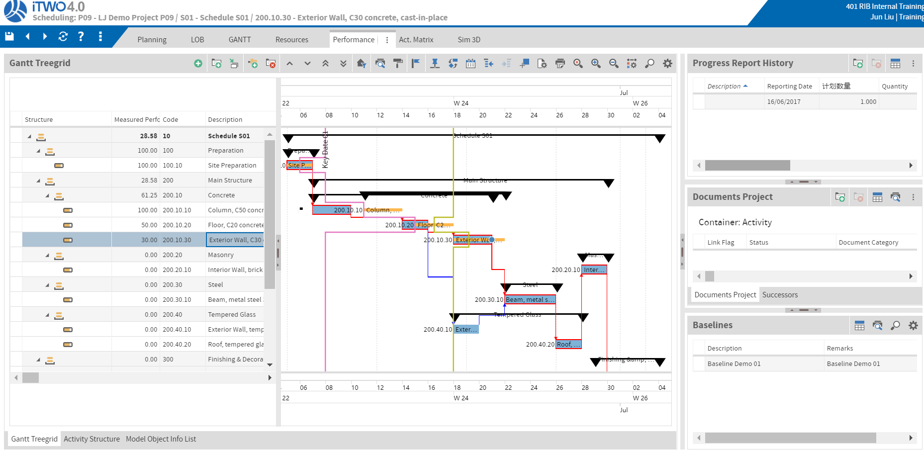
Schedule Demo – Schedule Performance
Add Progress History record.
Show Progress Lines

Slide 28
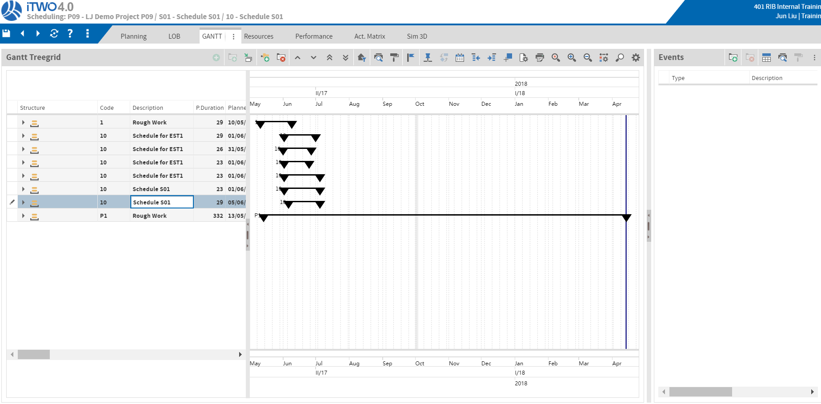
Schedule Demo – Multi Schedule
How to compare two or more different schedules in one GANTT chart?
Filter to filter all my project;
All schedules under my project could be showed together;

Slide 29
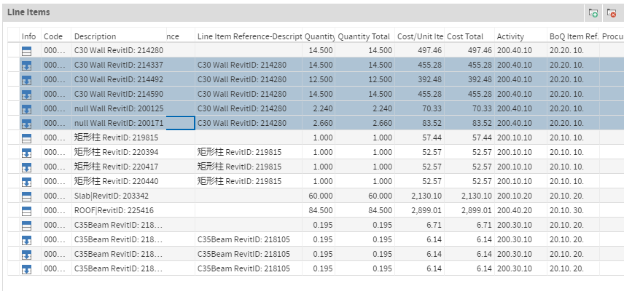
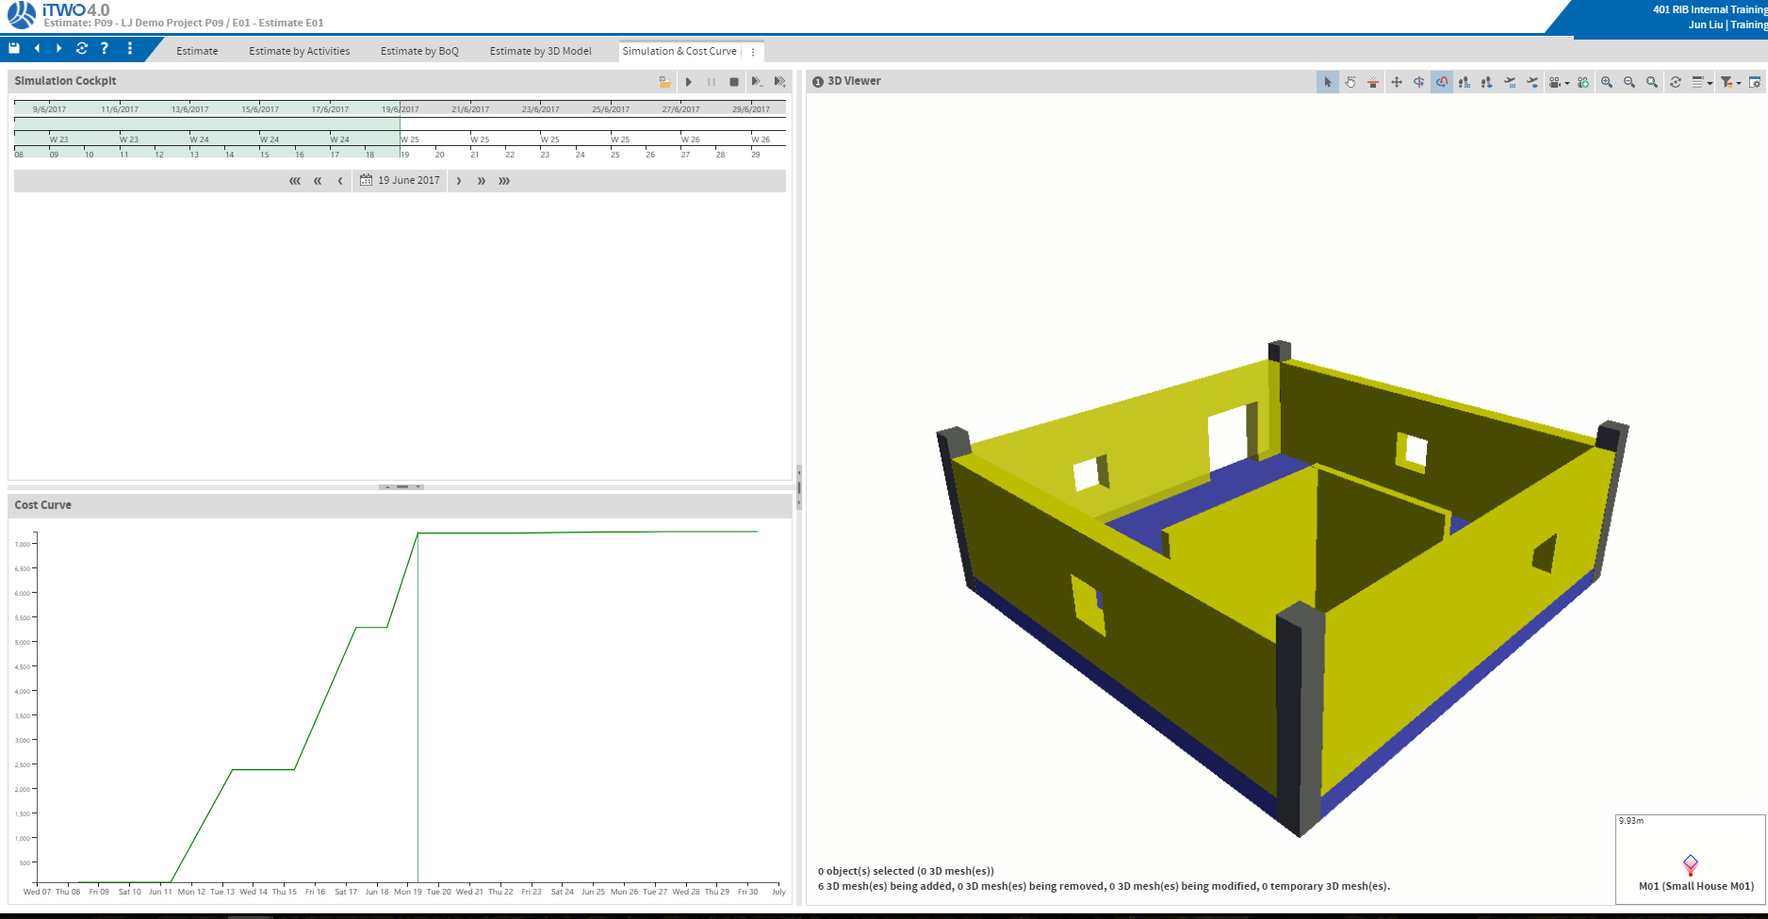
Schedule Demo – 5D SIM
Assign activities to the correlated Estimate line items;
Run 5D SIM from Estimate Details – Simulation and Cost Curve Tab.

Slide 30
Procurement

Slide 31
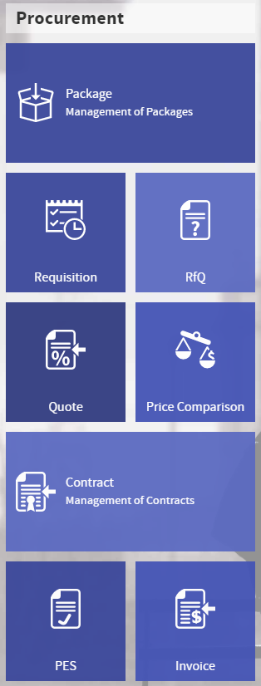
Procurement Overview
You can separate the sub-contract package (Material, Service, or Equipment) from Estimate to manage procurement process in iTWO 4.0.
You can use those packages for bidding, and then analyzing bidders’ Quote and deciding who awarded in iTWO 4.0.
You can still manage payment in those packages after creating Contract.

Slide 32
Procurement Workflow
Estimate
Equipment
BoQ
Material
Package
TENDERING
Request for Quotation
Requisition
Contract
PES
Invoice
Ticket System
Line Legend
Generate
Referenced
Quote
Price Comparison

Slide 33
Procurement Workflow
A Typical Procurement Workflow
Package
Requisition
Request for Quotation
Quote
Price Comparison
Contract
Performance Entry Sheet
Invoice
Package:
Group of Construction Work that is to be awarded
Requisition:
Identification, Qualification and Preparation of Demands
RfQ:
Standard Procedure to invite Business Partners for Tenders
Quote:
Estimate of Costs submitted by a Contractor to a prospective Client
Price Comparson:
Analysis and comparison of all the Quotes
Contract:
Contract based on a selected Quote
PES:
Records for Delivery Quantily and Date.
Invoice:
Payment and balance management

Slide 34
Procurement Steps
Create Procurement Package;
From Package Page, using Wizard to create a requisition;
From Requisition Page, using Wizard to create a RfQ;
From RfQ Page, using Wizard to create Quotes;
In Quote page, Press arrow in QUO code to go to Price Comparison;
From Quote Page, using Wizard to create a Contract;
Create PES, and link PES to Contract;
Create Invoice, and link Invoice to Contract & PES.

Slide 35
Procurement Tabs
Open tabs:
Administration Page
Estimate Details
Package Details
Schedule Details
Procurement Structure
Requisition
RfQ
Email Example
Quote
Price Comparison
Business Partner
PES
Invoice
Ticket System

Slide 36
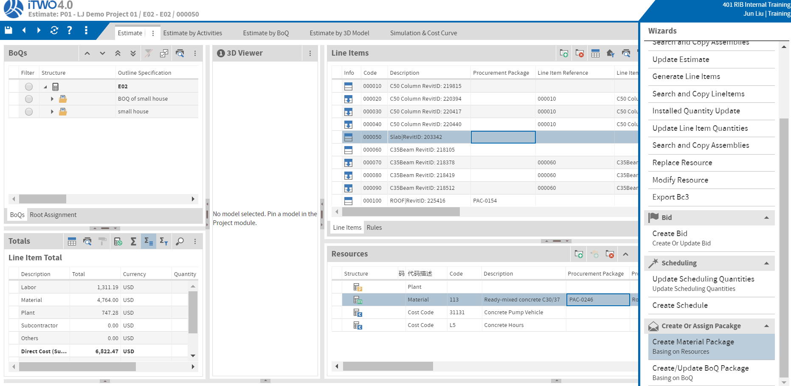
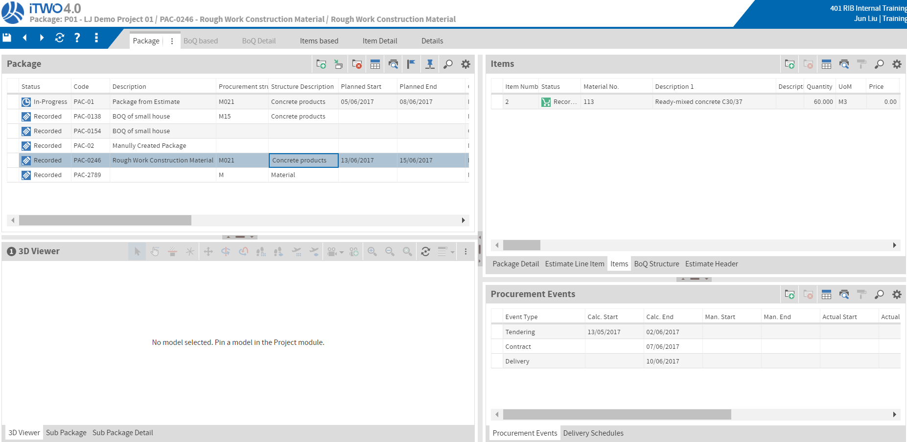
Procurement Demo - Package
3 ways to create procurement package:
In Estimate Details tab:
Two ways to create package: Wizard-> Create Material Package or Wizard-> Create BoQ Package
In Package Details tab:
The 3rd ways to create package: manually create a package
Show package details [Fill Schedule/Activity, Wizard->Evaluate Events, Wizard->Update Scheduling]
Show Procurement Events
Show package items [Wizard->Generate Items]

Slide 37
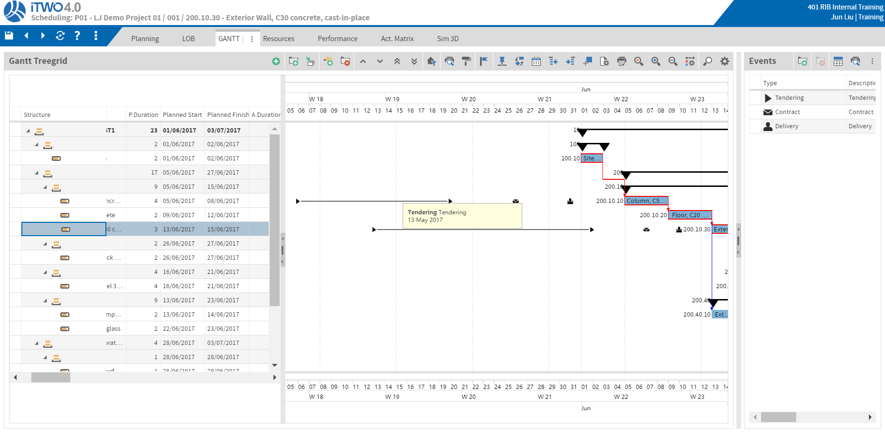
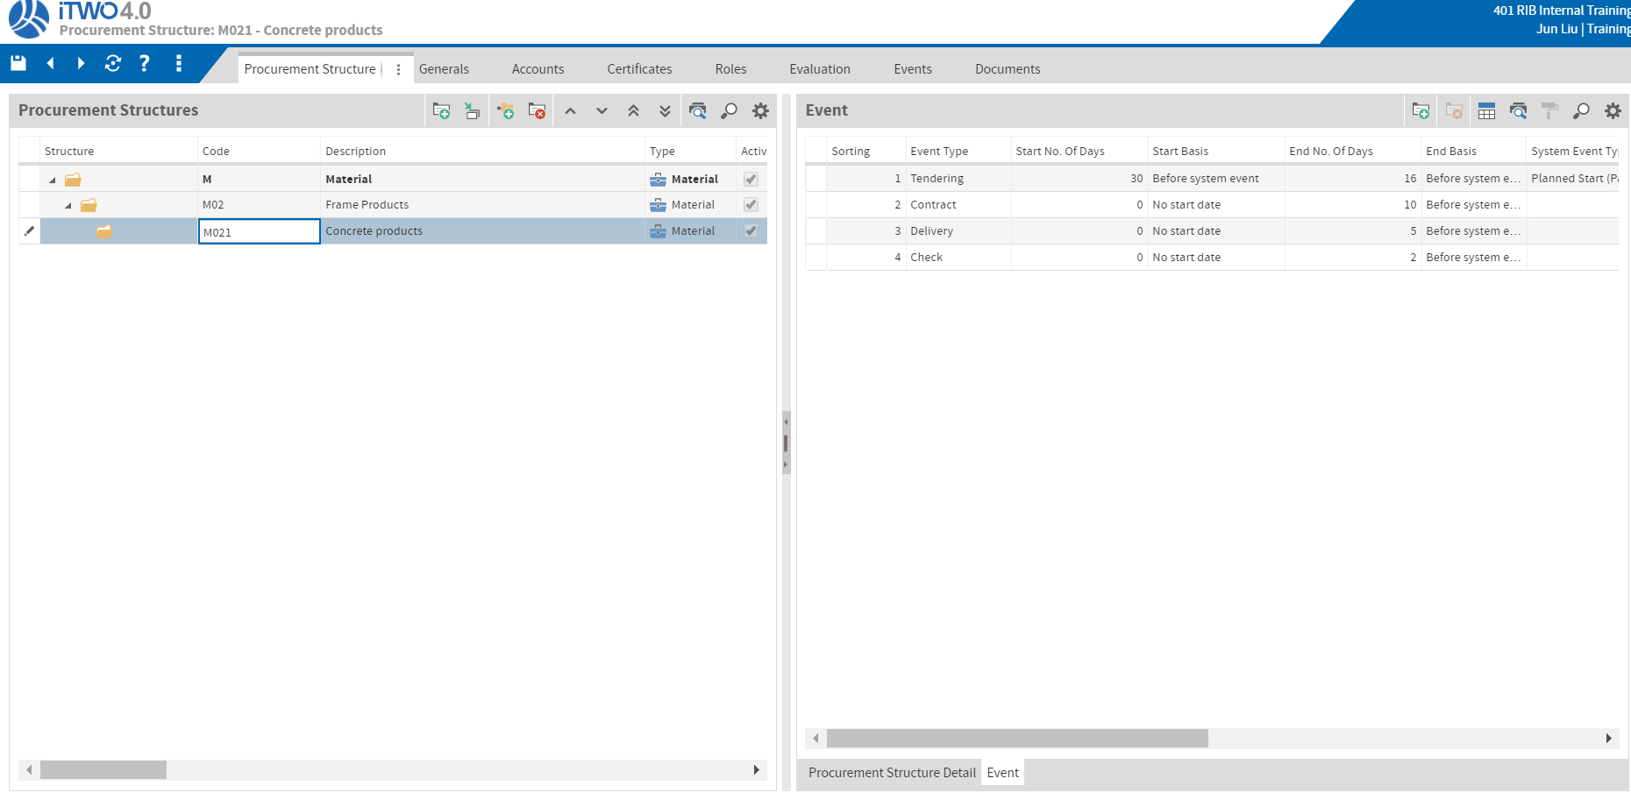
Procurement Demo - Procurement Schedule
In Schedule Details tab:
Show Tendering/Contract/Delivery Event
This is defined in Procurement Structure
In Procurement Structure tab:
Show Tendering/Contract/Delivery Event Definition

Slide 38
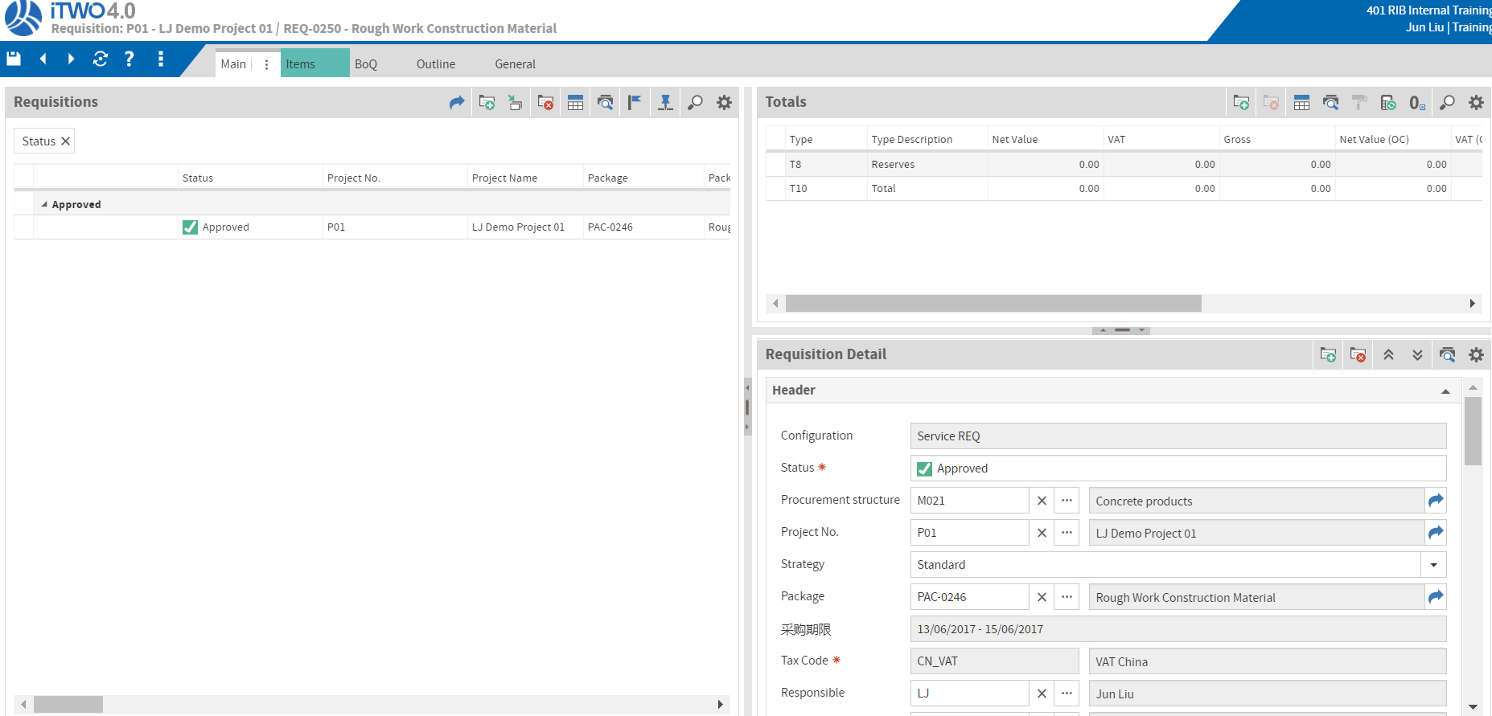
Procurement Demo - Requisition
From Package Details tab, Wizard->Create Requisition
In Requisition tab,
Show Requisition Details in Main tab and Item Details in Item tab
From Requisition tab, Wizard->Create RfQ

Slide 39
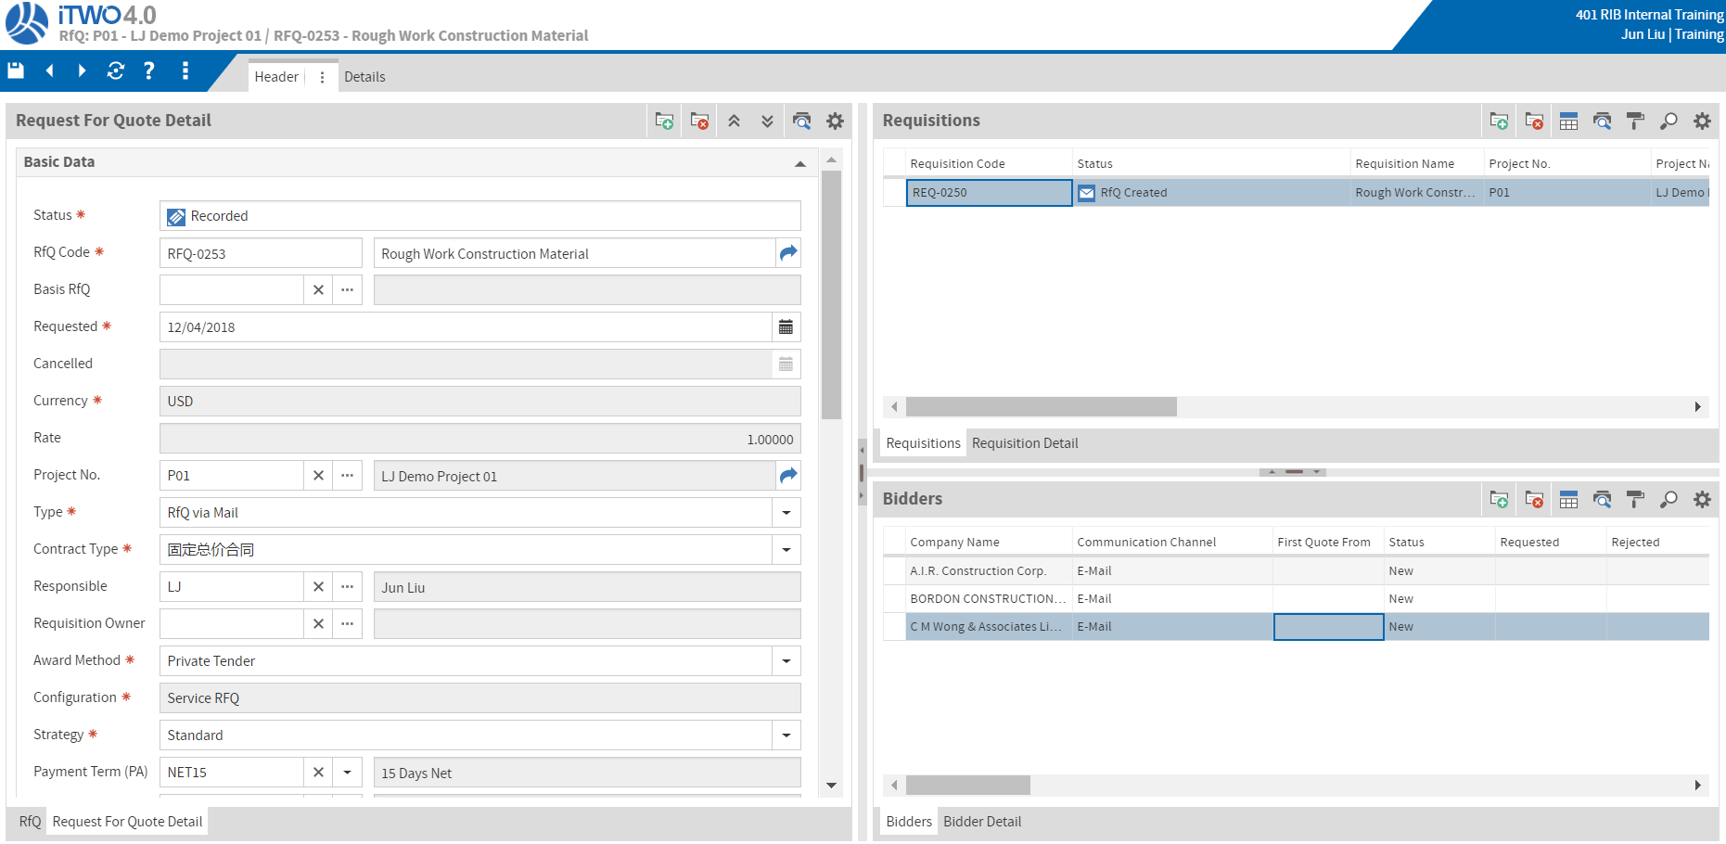
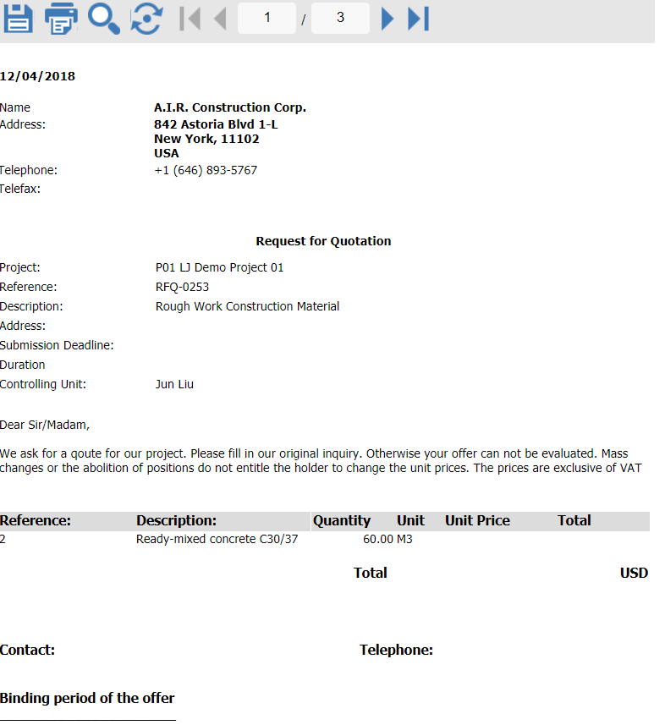
Procurement Demo - RfQ
In RfQ tab,
Show RfQ Details
Show bidder Details [Button->Add Bidder]
Show Sending email [Wizard->Send Email]
In Email Example tab,
Show Email Details

Slide 40
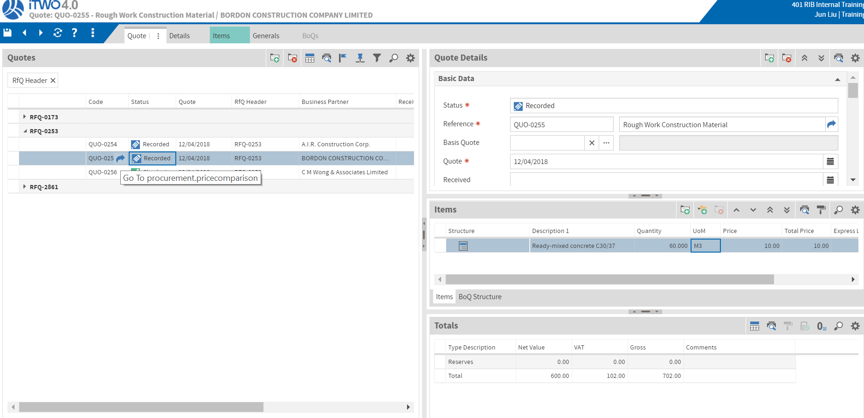
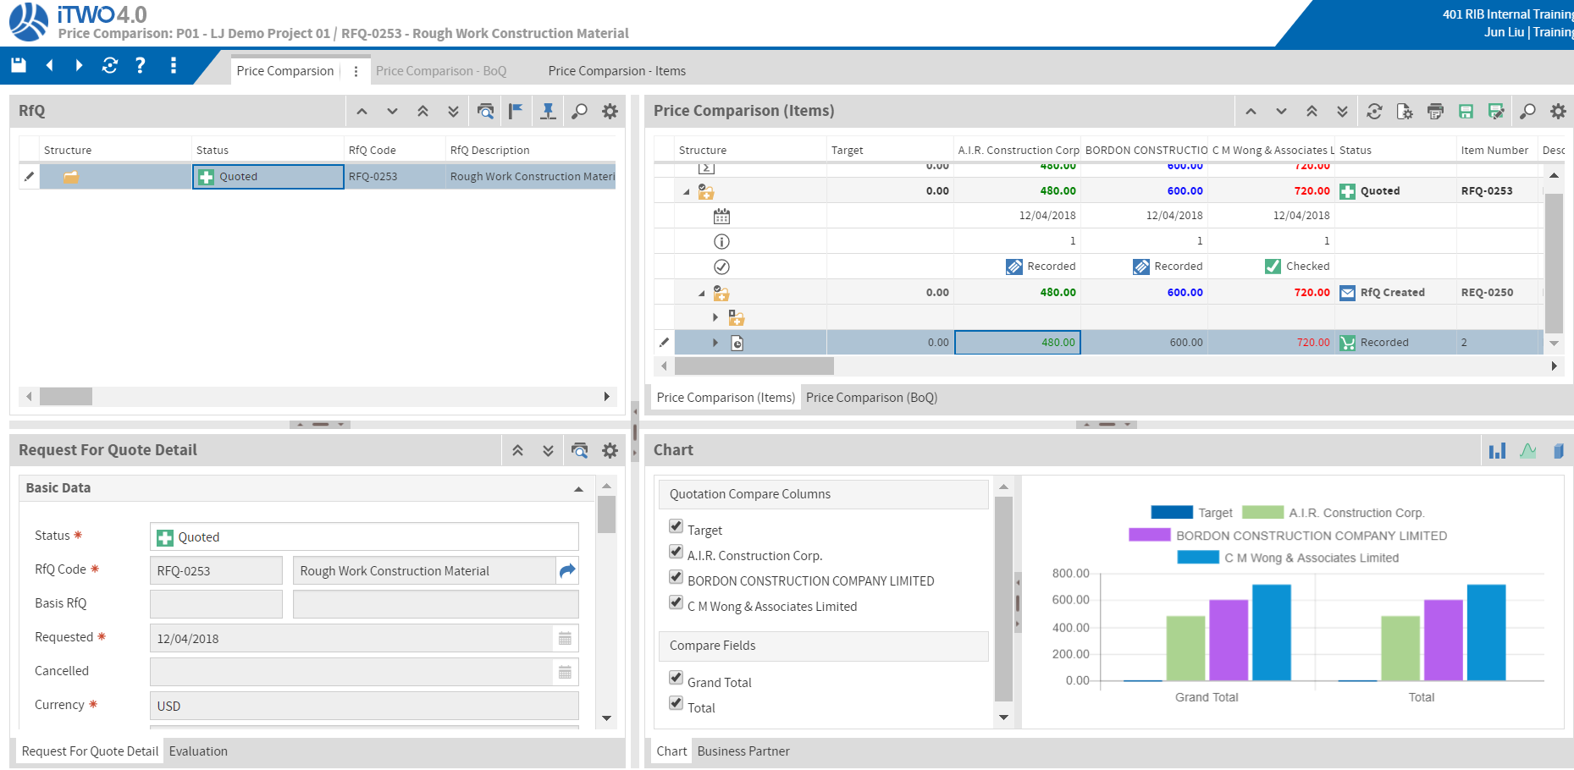
Procurement Demo - Quote
From RfQ tab, Wizard->Create Quote (do it for all bidders)
In Quote tab,
Show Quote Details
Show how to change Price
Press arrow in QUO code to go to Price Comparison
In Price Comparison tab,
Show Price Comparison Details

Slide 41
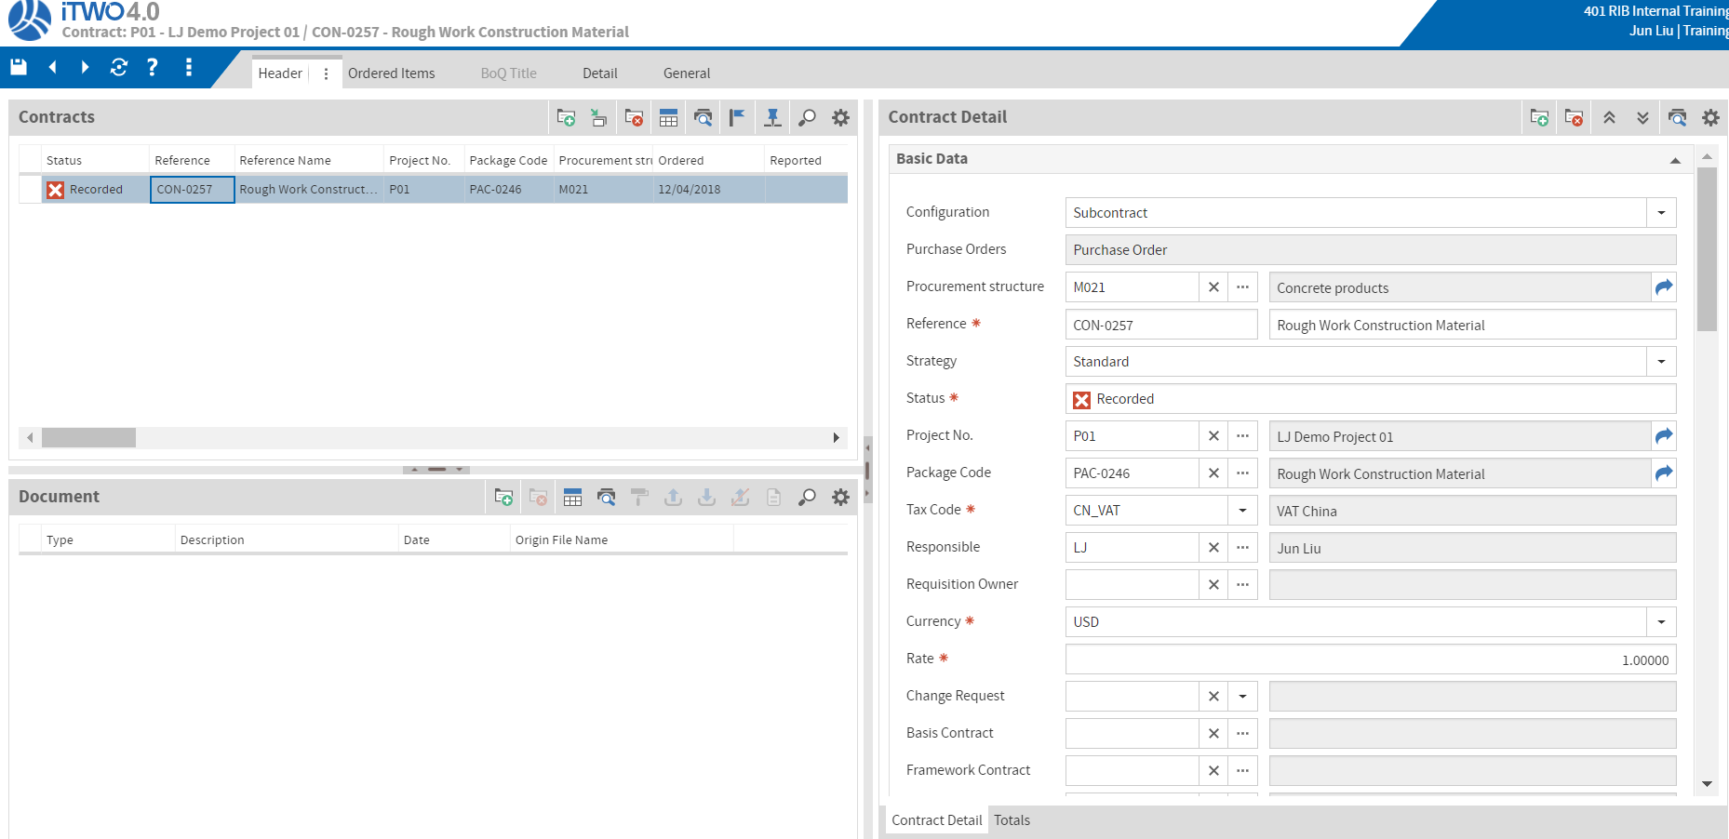
Procurement Demo - Contract
From Quote tab, Wizard->Create Contract
In Contract tab,
Show Contract Details

Slide 42
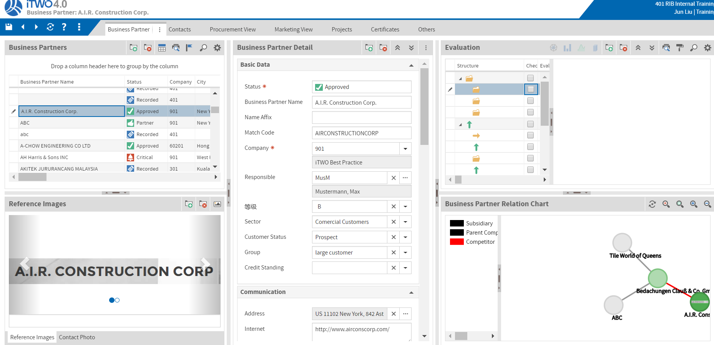
Procurement Demo - BP
From Contract tab, Wizard->Create BP Evaluation
In Business Partner tab,
Show Business Partner evaluation Details

Slide 43
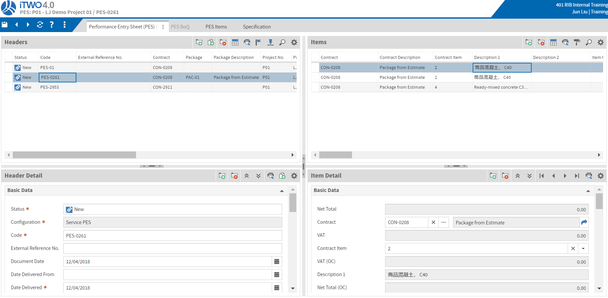
Procurement Demo - PES
In PES tab,
Add PES record
In PES sub tab, Show PES Details and PES Items Details

Slide 44
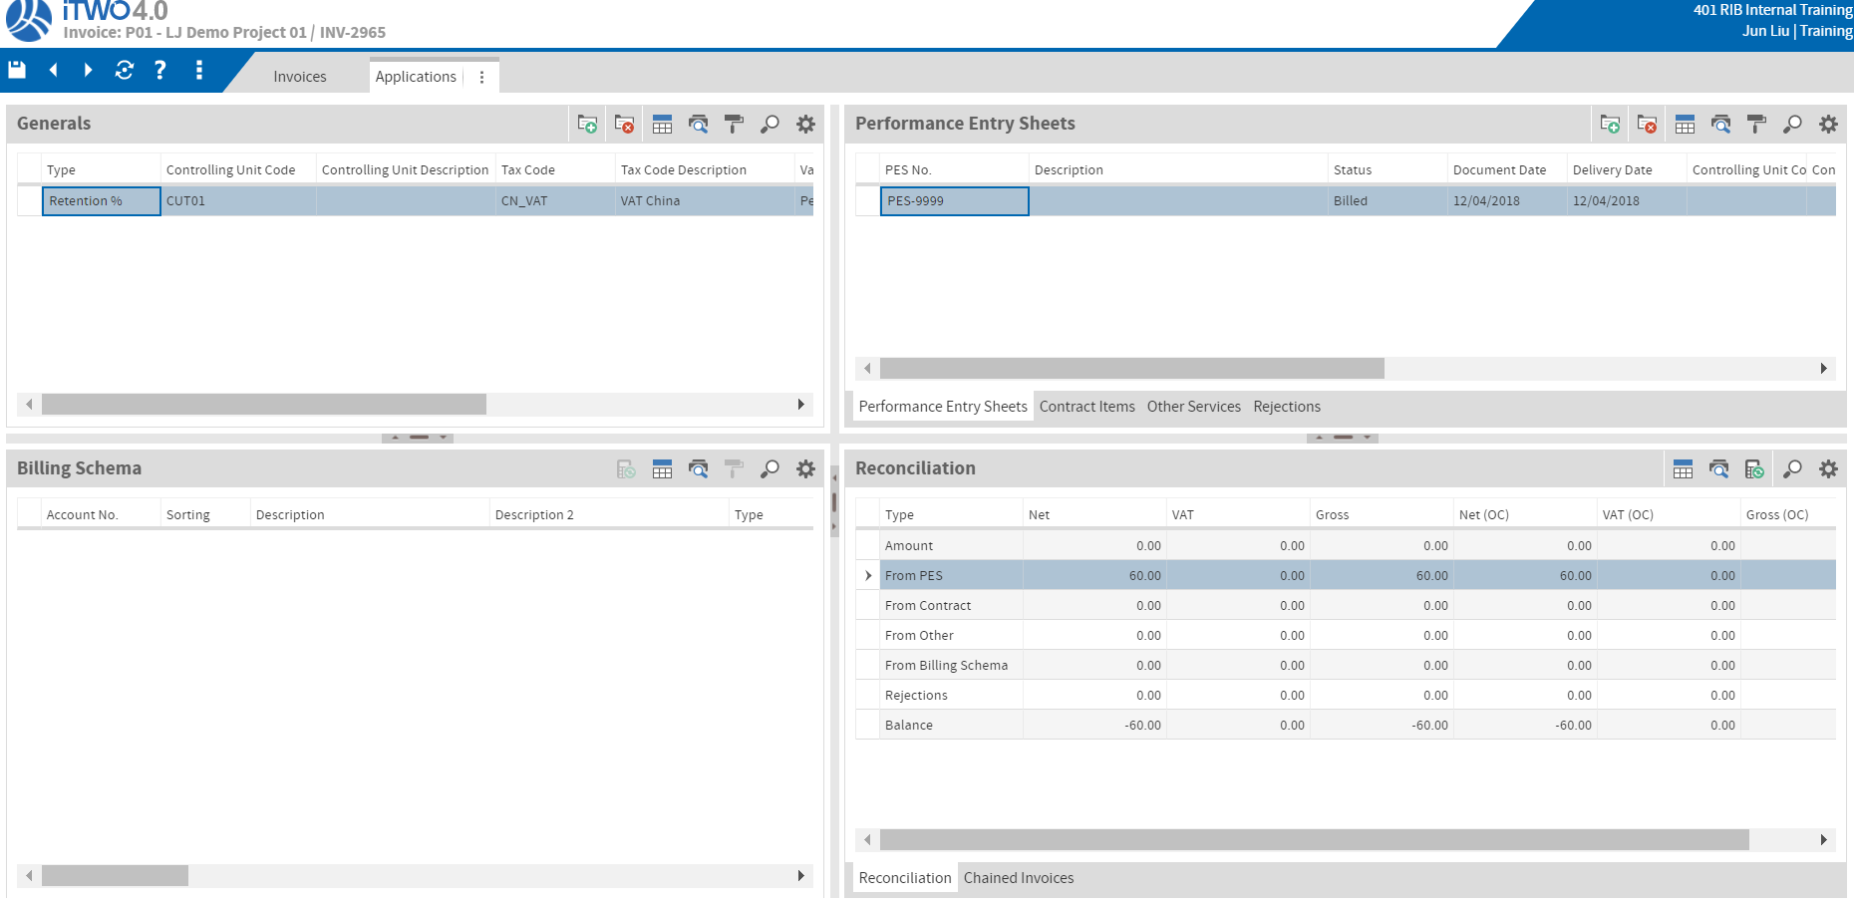
Procurement Demo - Invoice
In Invoice tab,
Add Invoice Record.
Show Invoice Details and Invoice Reconciliation

Slide 45
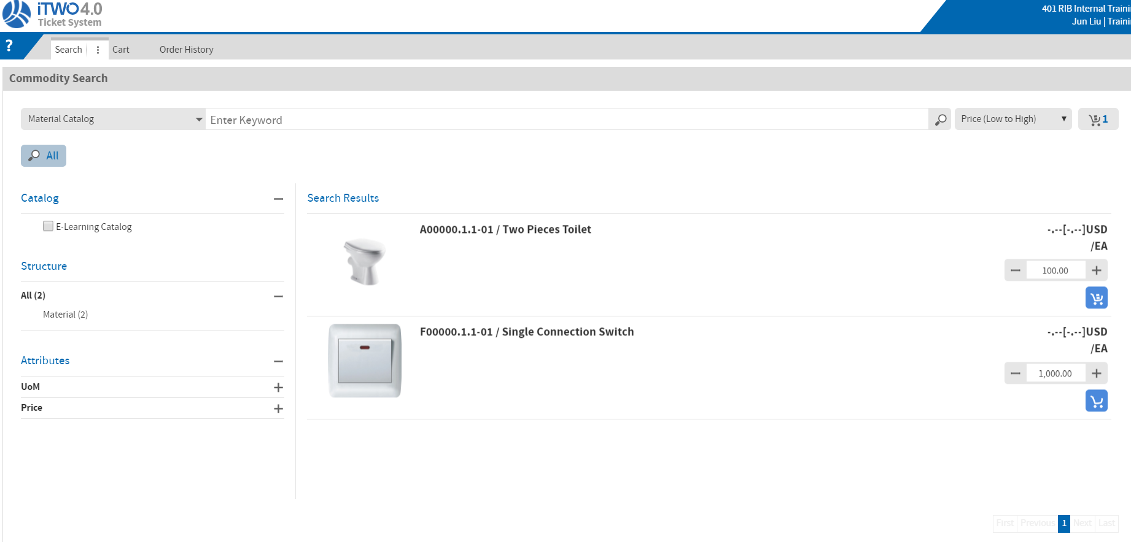
Procurement Demo - Ticket System
In Ticket System tab,
Add something into Shopping Cart
Show cart and order history
Place Order, jump to Requisition

